Slide 1
Identifying Erroneous Software Changes through
Self-Supervised Contrastive Learning on Time Series Data
Xuanrun Wang¹, Kanglin Yin¹, Qianyu Ouyang¹, Xidao Wen¹, Shenglin Zhang²,
Wenchi Zhang³, Li Cao³, Jiuxue Han⁴, Xing Jin⁴, Dan Pei¹
¹Tsinghua University， ²Nankai University
³Bizseer， ⁴China Construction Bank
Notes:
Hello, everyone.
I am Xuanrun Wang from Tsinghua University, China.
Today I will introduce our latest work: ‘Identifying Erroneous Software Changes through Self-Supervised Contrastive Learning on Time Series Data’ to you.

Slide 2
Background
Design
Evaluation
Conclusion
Notes:
Our presentation is structured into the following 4 sections.

Slide 3
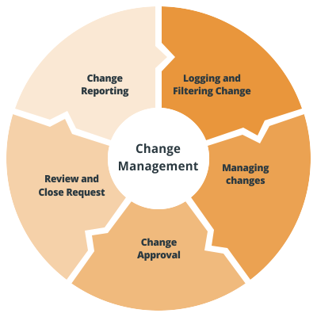
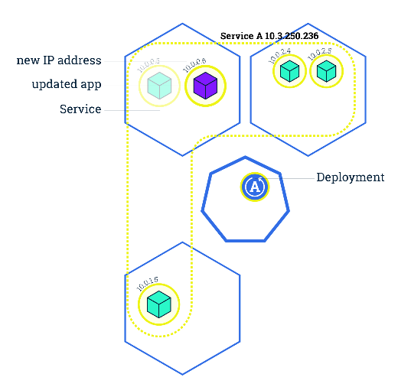
Software Changes
Software change is a critical approach
New functions
Bug Fix
Modify configurations
Software change management workflow
Before (Request, Impact Analysis, Decisioning)
Ongoing (Deployment)
After (Review, Reporting)
Some key characters of software changes
Frequent
Unavoidable
Wide-range influence
Notes:
With the software industry’s fast pace of development, software systems are playing a major role in our daily life.
Internet-based software services are invading every aspect of people’s lives.
However, as the basic infrastructure of the Internet, software service systems need to upgrade frequently.
Possibly adding new functions, fixing bugs, or modifying configurations.
These upgrades, or software changes, are frequent, unavoidable, and have a wide range of influences due to the complex dependencies.
To keep the software change process away from unexpected failures or accidents, operation engineers have set up a software change management workflow.
In the workflow, detailed requests, impact analysis, and change decisions are processed carefully before the change to ensure the change will proceed as expected.
When deploying the software change, several strategies like blue-green deployment are conducted, reducing the risk of erroneous changes.
After deployment, a software change review will monitor the system and check if new functionalities work properly.

Slide 4
Influences of Erroneous Software Changes
Research shows that 16% of the failures of cloud services are caused by software changes. ¹
In Oct. 2021, some services of Facebook accidentally down in several countries, whose root cause was software changes in the backbone network routers.
In Nov. 2021, Tesla callback 11,700 vehicles due to the risk of rear-end collision rising up after an erroneous software change.
Some fatal failures cannot be avoided by pre-change checks and software change deployment strategies. Thus, the only solution to avoid or mitigate them is to perform post-change monitoring.
¹ Gunawi, Haryadi, et al. Why does the cloud stop computing? lessons from hundreds of service outages. 2016
Notes:
Here are some of the accidents caused by erroneous software changes.
These changes must have passed a complete check before their deployment, but some latent bugs remained undiscovered until the accident happened.
As we can see a huge amount of economical loss is caused by merely an erroneous software change, highlighting the necessity of software change monitoring.
[单击]
These accidents inspire us that, some fatal failures cannot be avoided by the approaches executed before or during the software change.
Therefore, we have to perform post-change monitoring to make sure the software change works as expected.

Slide 5
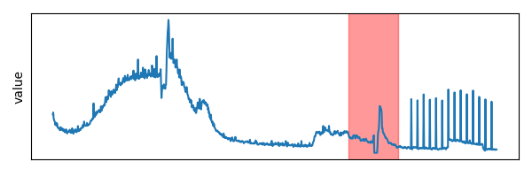
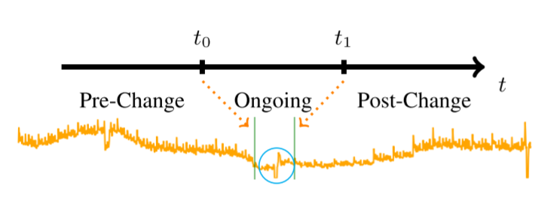
Concept Introduction
KPI (Key Performance Indicator)
Machine-level metric data, e.g. CPU Utilization
Business-level metric data, e.g. Transaction Success Rate
Software change workflow
Erroneous software changes
Given KPI changed substantially before and after the software change, which diverged from the regular pattern shown in the historical data.
The appearance of a KPI, where the red shadow indicates the ongoing period. An obvious shape variation exists before and after the change.
The appearance of a KPI before and after a software change.
Notes:
Here are some concepts we will use in our presentation.
KPI, which stands for Key Performance Indicator, indicates the running states of the system.
For instance, CPU Utilization can reveal the basic layer CPU status, while Transaction Success Rate shows the business results from a higher layer.
A software change workflow contains 3 steps shown in the figure.
$t_{0}$ [单击] is the time point when the system starts deploying the software change, and $t_{1}$ [单击] is when the deployment finishes.
[单击]
The period before $t_{0}$ is what we call the ‘pre-change period’, and the one after $t_{1}$ is the ‘post-change period’.
The period between $t_{0}$ and $t_{1}$ is the ‘ongoing period’.
In our next sections, we will use these terms.
Note that there is a jitter in the blue circle, which means the data during deployment might contain turbulence, which is not reliable for algorithms.
The figure on the right side shows a real case in our empirical study. [单击]
The red shadow shows the range of the ongoing period.
After the change, the shape of the KPI changed abruptly and is obviously different from the one before the software change.
This is due to the software change being erroneous, making the KPI’s shape diverge from the regular pattern shown in the historical data.

Slide 6
Our Goal
Rapidly identify whether a software change is an erroneous software change based on its related KPIs.
Notes:
Noticing all the problems, our goal is to identify whether a software change is erroneous rapidly using its related KPIs.

Slide 7
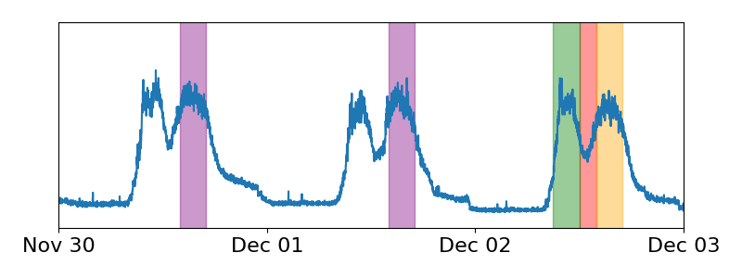
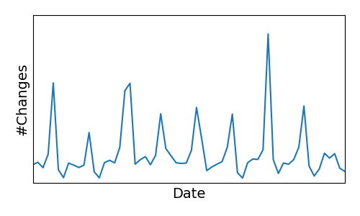
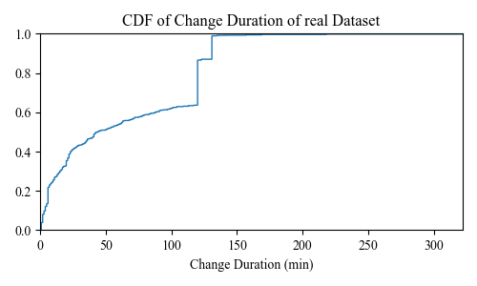
Empirical Study
Erroneous Software Change Identification Workflow in Practice
Software change deployment
Compare pre-change and post-change data
Make decisions based on domain knowledge
Massive number of KPIs to be checked simultaneously
Low accuracy
Different anomaly criteria of the KPIs
Number of software changes per day in a 2-month period.
The peak of which is ~1k.
The appearance of a KPI in a 3-day period. Operators usually compare corresponding colored periods to identify erroneous software changes.
The colored shadows indicate contemporaneous historical, pre-change, ongoing, and post-change data, respectively.
CDF of software deployment duration in our study.
Notes:
According to our empirical study, we found that in the large-scale data center, post-change monitoring could be divided into 3 parts.
The first is to deploy the software change.
After that, operator engineers initially use traditional algorithms like t-Test, DTW, or Pearson to compare pre-change and post-change KPI data automatically.
If the algorithms report that the KPI before the change differs from the one after the change, a knowledge-based manual double-check is then carried on.
The software change would be rolled back then if the operator regarded the difference in the KPI as an anomaly.
Currently and commonly, they use the following approach to compare the KPI data:
See the figure on the left.
Red shadow is for the ongoing period, orange for post-change, green for pre-change, and purple for the contemporaneous historical period of the post-change one.
By comparing these periods, operators can have the verdict of whether the KPI is erroneous after the software change.
The figures on the right show the number of software changes per day in 2 months.
Where the peaks are about 1 thousand.
The duration distribution of the ongoing period is shown in the right bottom figure.
We can see most of the software changes takes quite a long time to deploy, which is not a transient process.
[单击]
In our empirical study, we found three key obstacles to using current approaches to identify erroneous software changes:
The first is that the number of KPIs to be checked simultaneously is massive.
For each software change, there are hundreds of instances, and each has thousands of KPIs that need to be monitored, making the total number of KPIs a rather large number.
The second is that current approaches fail to achieve reasonable accuracy.
The third is that KPIs with different anomaly criteria should be paid attention to, since contrastive approaches including t-Test may ignore the difference among the KPIs.

Slide 8
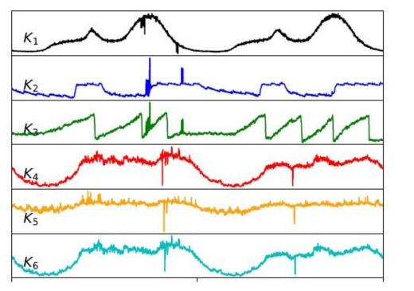
Challenges
Lack of domain knowledge
Different anomaly criteria
Supervised learning approaches
#KPI * #Instance * #Systems → Millions of KPIs per change
Massive number of KPIs
Efficiency is critical
Thresholds are ambiguous for general approaches
Unrealistic to label training data manually
e.g. Success Rate v.s. Memory Usage
Notes:
We then summarize the challenges in our work:
First, there is a lack of domain knowledge for the operation engineer and researcher to manually label the dataset.
They have no idea to determine whether a software change is erroneous and whether a KPI should be related to an erroneous software change.
Thus, supervised learning approaches are no longer available.
Second, there are a massive number of KPIs to be checked simultaneously.
Based on our analysis, there are more than a million KPIs that should be monitored in the peak period and all the results should be obtained within several minutes.
Thus, the efficiency of the algorithm is essential.
Third, we have to consider different anomaly criteria of the KPIs.
For example, when checking the KPI of success rate, it should be more strict than checking the KPI of memory usage.
For those contrastive approaches like the t-Test, it’s difficult to determine the exact threshold for every KPI to use.

Slide 9
Background
Design
Evaluation
Conclusion
Notes:
Here, we start to describe our approach.

Slide 10
Core Idea
Parallelizable
Non-KPI-specific
Generic model
Historical data
Heterogenous KPI data
Unified anomaly results
Post-change data
Use a limited number of generic models to check whether a KPI obeys its historical patterns.
Notes:
The input KPI time series are heterogenous in their shapes and appearances.
To prevent introducing prior knowledge into the algorithm, a unified anomaly result should be obtained for each KPI.
[单击]
Regarding this, a generic contrastive model is needed, making it non-KPI-specific.
Moreover, as we need a highly effective approach, a generic model, rather than a KPI-specific model is required, too.
Since it is easy to run a generic model parallelly, resulting in high throughput.
[单击]
To sum up, we need one, or a limited number of generic models to check whether a KPI obeys its historical patterns.

Slide 11
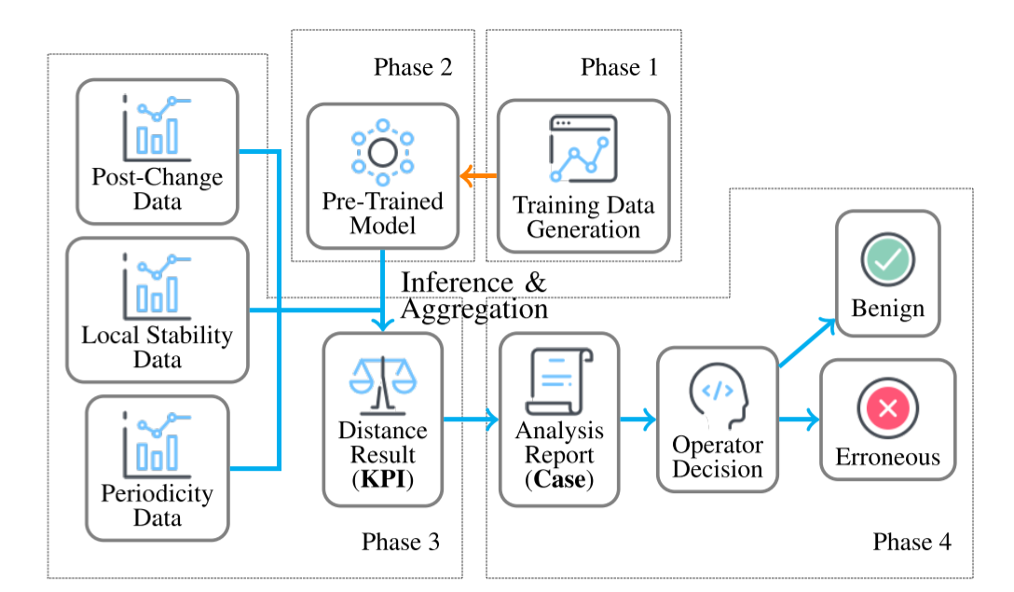
Kontrast Design
KPI Contrast
Notes:
Our model, Kontrast, is composed of 4 phases shown in the figure.
[单击]
The name Kontrast is an abbreviation of KPI Contrast.
Next, we will introduce each of them in an order that is easy for you to understand.

Slide 12
Kontrast Design
Two Key Observations of Normal KPIs
Periodicity (P)
Local Stability (LS)
Patterns tends to be similar in the same time of the periods (Contemporaneous historical & post-change)
Patterns tend to be similar within a short period before and after the ongoing period (pre-change & post-change)
Notes:
First, we introduce 2 key observations of KPIs in the normal state.
Periodicity means that the normal KPI data follows a periodical pattern inferred from its historical appearance.
For example, see the contemporaneous historical periods are similar to the post-change period.
Local Stability means that the KPI data does not change abruptly in a relatively short time.
It may follow the macroscale trend, but when the scope is rather small, dramatic change is not allowed in the normal KPI data.
Thus, the pre-change period and the post-change one should not differ too much.

Slide 13
Kontrast Design
Data Extraction Specifications
$$X^{P}⋯$$
$$X^{P}$$
$$X^{P}$$
$$X^{LS}$$
$$X′$$
$$T$$
By checking whether $X′$ is similar to $X^{LS}$ and $X^{P}$, we can determine whether the KPI is abnormal.
Notes:
Let’s have a formal notation of these colored periods first.
As the same in our paper, we denote the post-change period as x prime, [单击]
the pre-change period as x-LS, [单击]
and the contemporaneous periods as x-Ps. [单击]
T is the length of one period. [单击]
By checking whether x prime is similar to x-LS and x-P, we can determine whether the KPI is abnormal.

Slide 14
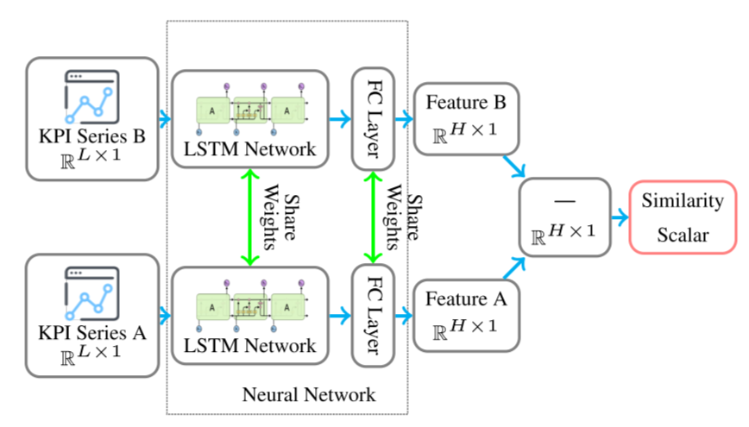
Kontrast Design
Model Design
Training Input: Time series segment $A, B$ and a similarity label
Output: A similarity score
P model: compare $X^{P}$ and $X′$
LS model: compare $X^{LS}$ and $X′$
Inspired by the contrastive learning technique, the Siamese-Network-based model determines the similarity of two time series segments.
Notes:
Then we move on to the neural network structure of our model.
[单击]
Inspired by the contrastive learning technique, the Siamese-Network-based model determines the similarity of two time series segments.
Siamese network is a classical architecture in the contrastive learning domain.
The weights of its two LSTM branches are shared, making it capable of decoding two input series using the same set of weights.
[单击]
Using labeled pairs of time series, we can force the network to learn the similarities and dissimilarities of the input time series based on the label.
Finally, a fine-tuned network can produce a binary classification result: Whether the two samples are similar or not.
Here we denote the model processing x-prime and x-P as the P model and processing x-prime and x-LS as the LS model.

Slide 15
Kontrast Design
Training Data Generation
Why must we divide the KPIs into several categories first?
Problem: Using the Siamese network, we need a (pseudo) labeled dataset!
Solution: Generate a labeled dataset using unlabeled by data augmentation.
Different KPI have different anomaly criteria
Divide the KPIs based on their historical appearance
5 types of randomized noise injection methods
Derived from the analysis of historical KPI patterns
Notes:
Here we meet with a problem: We have no labeled dataset, while our model needs a fully labeled one.
[单击]
To tackle this, we decided to utilize a data augmentation technique, generating a labeled dataset using the unlabeled one.
[单击]
Here is the procedure of data augmentation.
We first extract some historical normal KPI segments, then divide them into several noise intensity categories.
[单击]
Why do we need to divide them first?
[单击]
As we mentioned before, different KPIs have different anomaly criteria, so we have to process them separately, regarding their historical appearances.
This classification is purely a statistical approach which could be found in our paper.
[单击]
After that, we have 5 types of randomized noise injection methods, which are derived from the analysis of historical KPI patterns, as shown in the figure.
Using the noise-injected pseudo-labeled dataset, we can train several models, each of which is capable of dealing with the KPIs with a certain noise intensity level.

Slide 16
Kontrast Design
Training Data Generation
Noise Injection
Similar pairs (Negative cases)
Randomly pick contemporaneous KPI segments as $A$ and $B$
Inject mild noises (considering the category) into $A$ → $A′$, $B$ → $B^{′}$
→$<A^{′}, B^{′}, 0>$
Dissimilar pairs (Positive cases)
Randomly pick KPI segments as $A$ and $B$ (contemporaneity is not required)
Inject significant noises (considering the category) into $A$ → $A′$, $B$ → $B^{′}$
→$<A^{′}, B^{′}, 1>$
Kontrast: A self-supervised contrastive learning approach
Notes:
We now discuss the detailed noise injection approach.
To generate similar pairs, we randomly pick contemporaneous KPI segments as A and B and then inject mild noises into them considering their noise intensity category.
Then, the injected pair is a similar pair with a negative label.
For dissimilar ones, we randomly pick KPI segments as A and B and then inject significant noises into them, also with consideration of their noise intensity category.
Note that here contemporaneity is no more needed.
We then get the injected pair as a dissimilar pair with a positive label.
[单击]
In this way, Kontrast is now a self-supervised contrastive learning approach.

Slide 17
Kontrast Design
Erroneous Software Change Identification
Aggregate similarities from P model and LS model
By weighted sum of:
Maximum similarity from multiple $X^{P},X′$ pairs
Maximum similarity from multiple 𝑋^𝑃,𝑋′ pairs
Aggregate results from multiple KPIs
Similarity from $X^{LS},X′$ pair
Similarity from 𝑋^𝐿𝑆,𝑋′ pair
Trigger alerts by pre-set regulations or thresholds
Threshold
Why maximum?
Being similar to any of the historical patterns is enough!
Notes:
In the end, we introduce how we aggregate the results.
After performing the calculation of the model, we have several similarity values for a KPI.
We first aggregate them, to get the anomaly judgment of this KPI.
By adding them together, we have the weighted sum of the similarities obtained from the P model and the LS model.
Since there are multiple X-Ps, we have to have the maximum similarity from them first.
[单击]
Why is this? Because the post-change period is judged normal if it is similar to any of the contemporaneous historical periods.
After obtaining the weighted sum, we can use a threshold to determine whether the KPI is erroneous.
For judging the software change, we use manually pre-set regulations and thresholds to make the final decision.
That’s all of our model design.

Slide 18
Background
Design
Evaluation
Conclusion
Notes:
We then move on to the evaluation of Kontrast.

Slide 19
Evaluation
Dataset Settings
Dataset A
Dataset B
Based on AIOps2018 Challenge dataset
Synthetic, collected from microservice-based benchmark system Hipster Shop¹
Original data + randomly chose change points
32 different problematic microservice software versions
Version switch → Software change, 336 cases, 34944 KPIs
368 KPIs
¹ https://github.com/lightstep/hipster-shop
Notes:
We tested Kontrast on two datasets.
Dataset A is based on the AIOps twenty eighteen Challenge, we use the original data and randomly chose some change points.
There are 368 KPIs in total.
Dataset B is a synthetic dataset, it is collected from a benchmark system called Hipster Shop, which is popular in our domain.
We implemented 32 different problematic microservice software versions and performed version switches, to simulate software changes.
There are 336 change cases and over 30 thousand KPIs.

Slide 20
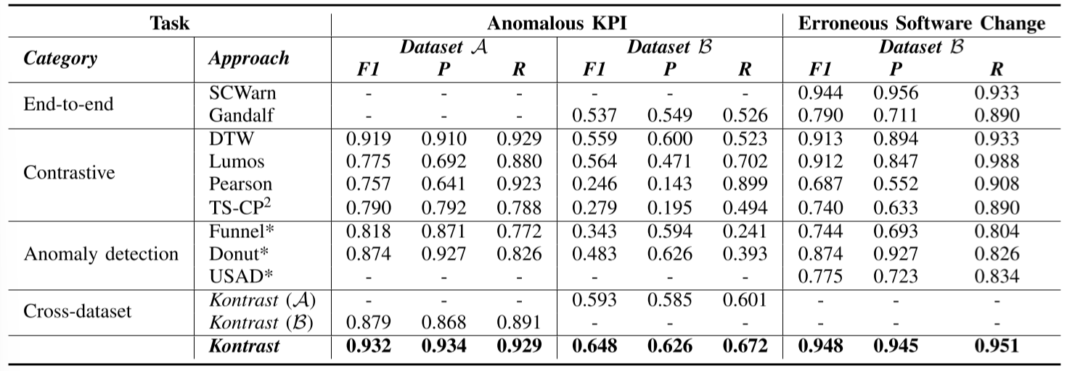
Evaluation
Overall Performance
Outperforming the majority of other approaches even if being trained and tested on different datasets
Contrast-based approach→ Excellent cross-dataset adaptability
Notes:
Our evaluation results show that Kontrast outperforms other baseline models.
[单击]
See the last row of the table, we can find that Kontrast gets a higher score on each of the two tasks.
Obviously, when being trained and tested on different datasets, Kontrast also outperforms the majority of other models, indicating its excellent cross-dataset adaptability.
[单击]
This is because that we train the model to distinguish anomalies, rather than to learn the normal patterns.
Although the normal patterns differ among the datasets, the anomalies stay similar.
Thus, contrastive methods like Kontrast can handle this task better.

Slide 21
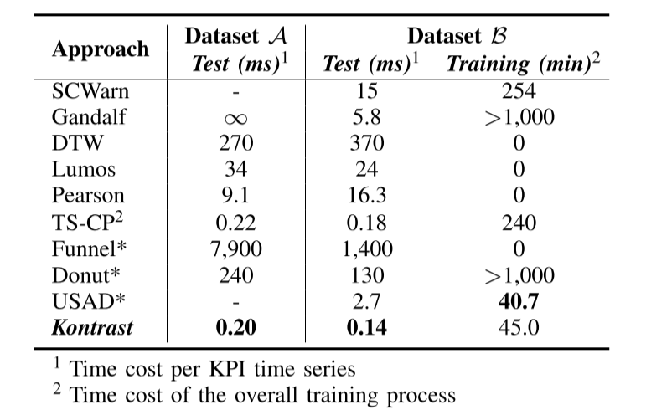
Evaluation
Time Usage
Irrelevant to the size of the training set
Directly proportional to a hyperparameter
The batch size could be quite large to reduce the average time cost
Contrast-based approach→ High parallel computation efficiency
Notes:
We can find out that Kontrast is hundreds to thousands of times faster than non-contrastive approaches in the testing phase.
[单击]
This is because Kontrast is a generic model, and heterogenous KPIs could be processed in a quite big batch, improving the efficiency magnificently.
[单击]
Meanwhile, the training time cost of Kontrast is also irrelevant to the size of the training set.
The training data generation is based on a randomized sampling process.
It is directly proportional to a hyperparameter.
[单击]
In summary, since Kontrast is a contrast-based approach, it possesses a high parallel computation efficiency.

Slide 22
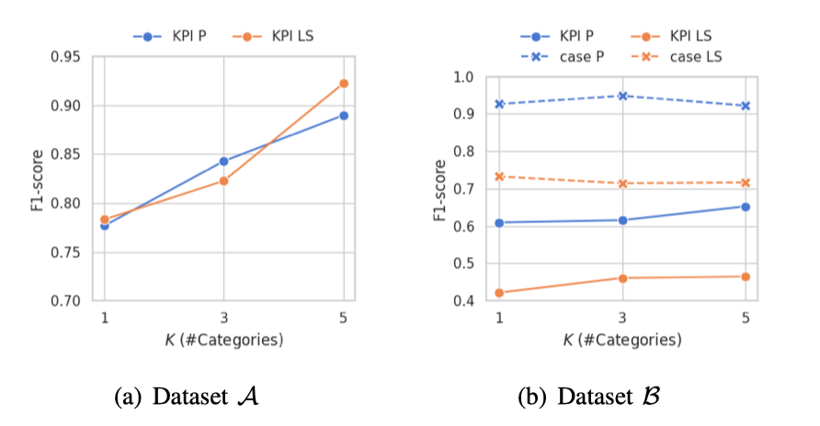
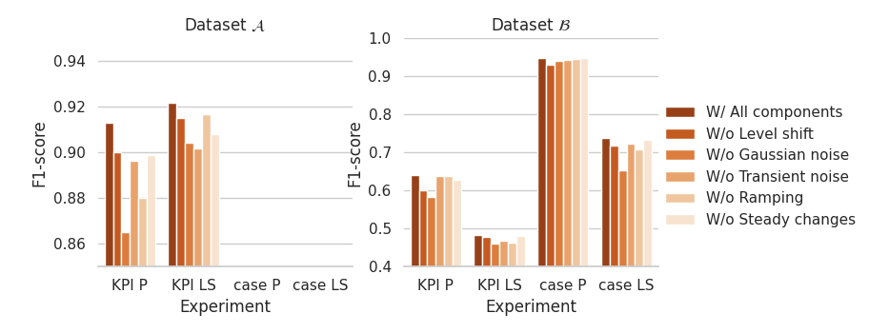
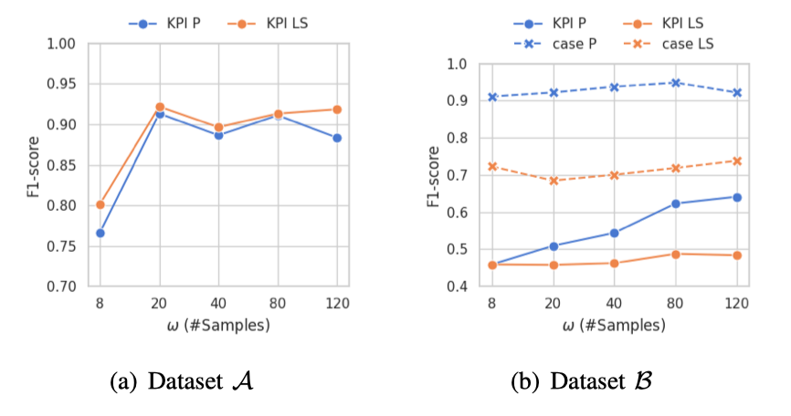
Evaluation
Ablation Study
KPI classification is necessary
All components of noise injection are effective
Accuracy and latency should be balanced
Detailed discussion of evaluation and ablation study could be found in our paper.
Notes:
Due to the time reason, we only show some ablation study results here.
A more detailed analysis could be found in our paper.

Slide 23
Background
Design
Evaluation
Conclusion
Notes:
In the end, we have a conclusion.

Slide 24
Conclusion
A comprehensive empirical study
Kontrast: an efficient, generic, and self-supervised contrastive learning approach
A novel KPI data augmentation approach
Opensource Kontrast
Reveal several key pain points of software change in the industries
Capable of handling massive number of KPIs
Capable of generating labeled time series data in the DevOps field
https://github.com/NetManAIOps/kontrast
Take different anomaly criteria into consideration
Domain-knowledge-based labeling is no more needed
Notes:
We have done a comprehensive empirical study on software changes in a global data center and revealed some key pain points of software change in industries.
We propose Kontrast, which is an efficient, generic, and self-supervised contrastive learning approach.
We propose a novel KPI data augmentation approach, it is capable of generating labeled time series data based on unlabeled one.
We solved the three challenges mentioned before via our model.
For better reproduction, we open-sourced our code on GitHub.

Slide 25
Thanks
Q&A
Notes:
Thank you for your listening, and questions are welcome.
18：34

